Slide 1
Titanic

Slide 2
What do we KNOW
WHAT do we want to know
What did we LEARN
Notes:
Eg. Rocks, concrete

Slide 3
Understand the history about the Titanic
Knowledge of what and how the Titanic catastrophe occurred

Slide 4
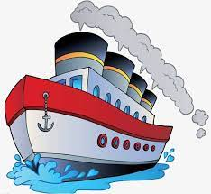
https://youtu.be/H_NryL40-lw
Video on website
Notes:
Eg. Rocks, concrete

Slide 6
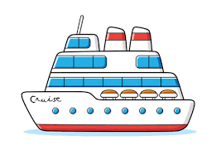
Question 1: What year did the titanic sink?

Slide 8
Question 2: What was the titanic believed to be?

Slide 10
Question 3:What caused the titanic to sink?

Slide 12
Question 4: What were 6 objects found on expeditions after the titanic sank?

Slide 13
Now answer these questions in full sentences in your English books
What year did the titanic sink?
What was the titanic believed to be?
What caused the titanic to sink?
What were 6 objects found on expeditions after the titanic sank?
Notes:
Question 1: 1912
Question 2: unsinkable
Question 3: iceberg
Question 4: plates, forks, decorations, personal belongings, glasses, clothing, perfume, bottles of olives, clocks, watches

