Slide 1
DAY ONE

Slide 2
Counting
Partitioning

Slide 3
I do
25
149
20
5
100
40
9
20 + 5 =
25
100 + 40 + 5 =
149

Slide 4
we do
78
921
70
8
900
20
1
70 + 8 =
78
900 + 20 + 1 =
921

Slide 5
We do
367
4356
300
60
7
4000
50
6
30 + 60 +7 =
367
300
4000+300+50+6 =
4356

Slide 6
You do!
84
47
99
187
430
762
836
3215
7682
1092

Slide 7
It’s Nothing New
Adding with Pim

Slide 8
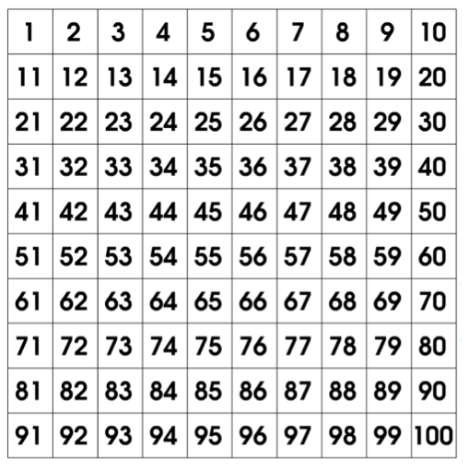
2 x Table
1 x 2 =
2
2 x 2 =
4
3 x 2 =
6
4 x 2 =
8
5 x 2 =
10
6 x 2 =
12
7 x 2 =
14
8 x 2 =
16
9 x 2 =
18
10 x 2 =
20
11 x 2 =
22
12 x 2 =
24

Slide 9
It’s Nothing New
Adding with Pim

Slide 10
I do
8 + 7 =
15
80 + 70 =
150
800 + 700 =
1500
8000 + 7000 =
15000
80 000 + 70 000 =
150 000

Slide 11
I/We do
800 + 400 =
1200
4000 + 7000 =
11000
90 + 90 =
180
80 000 + 90 000 =
170 000
4000 + 3000 =
7000

Slide 12
900 + 900 =
700 + 400 =
50 + 40 =
600 + 300 =
7000 + 2000 =
6000 + 3000 =
You do!

Slide 13
Calculations
Addition

Slide 14
83 + 42
44 + 71
95 + 47
86 + 19
54 + 33
You do!

Slide 15
WALT:
Represent numbers in a variety of ways
WILF:
Represent numbers in Standard, Written, Expanded form
Complete at least 5 examples.

Slide 16
Place Value to 100 000
There are 1000 unit cubes in each 1000 block.
How many unit cubes are there in the first row of this block?
We can count in 1000! Lets count together.
1000
2000
3000
4000
5000
6000
7000
8000
9000
10 000
There are 10 000 unit cubes in the first row.
We can write this in written form as
‘ten thousand’

Slide 17
So if we know there are 10 000 in the first row, how many are there altogether?
We can count in 10 000! Lets count together.
10 000
20 000
30 000
There are 30 000 unit cubes altogether.
We can write this in written form as
‘thirty thousand’

Slide 18
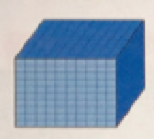
40 000
forty thousand
Lets try another example:
6000
six thousand
500
five hundred
40 forty
3 three
46 543
How many unit cubes do we have altogether?

Slide 19
Ten Thousands | Thousands | Hundred | Tens | Ones
4
6
5
4
3
4
0
0
0
0
6
0
0
0
4
6
5
4
3
5
0
0
Expanded Form:
4
0
40 000 + 6000 + 500 + 40 + 3 = 46543
3
Written Form:
forty six thousand, five hundred and forty three

Slide 20
I/we do
Standard Form | Written form | Expanded Form
12657
 | forty five thousand, three hundred and sixty one
341 36
 |  | 70 000 + 1000 + 900 + 20 + 8
 |  | 50 000 + 6000 + 300 + 30 + 2
 | thirty seven thousand, two hundred and eight

Slide 21
You do
Standard Form | Written form | Expanded Form
34124
 | twenty three thousand, two hundred and eleven
76213
 |  | 90 000 + 3000 + 500 + 10 + 3
 |  | 40 000 + 6000 + 500 + 80 + 0
 | ten thousand and eight seven

Slide 22
Groups
Level 1 **** | Level 2 *** | Level 3 ** | Level 4 *
Notes:
This will be determined by the results in the pre test ☺ You may have more or less!
Level One: Hardest (Challenges)
Level Two: At with some challenges
Level Three: With some support needed
Level Four: Small guided group

Slide 23
Plenary
Identifying the value of numbers within 4-5 digit numbers.
What is the value of the underlined digit?
84 366 – 4000
9051 - 50
92 682 - 2000
14 705 - 700
32 111 - 10
10 439 - 9

