Slide 1
DAY TEN

Slide 2
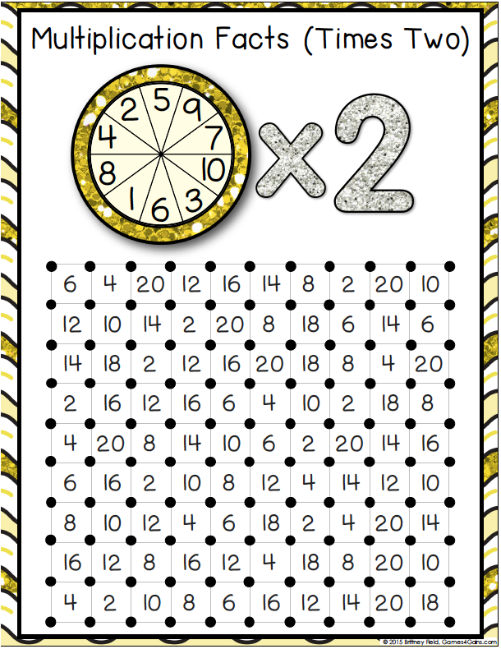

Slide 3
WALT:
To round numbers to the nearest 10
WILF:
Use a number line
Know the rounding rule

Slide 4
Rounding to the nearest 10…
1
5
2
6
3
7
4
8
9
Revise what students learnt about rounding to the nearest 10 last lesson. We/you do activities on the IWB and mini-whiteboards.

Slide 5
We do!
You do!
34 ≈
16 ≈
232 ≈
45 ≈
4356 ≈
213 ≈
3287 ≈
4321 ≈
9809 ≈
2318 ≈
4541 ≈
6574 ≈
23,456 ≈

Slide 6
Using Rounding to Estimate

Slide 7
We can use a number line to help us when we are rounding.
Lets work out how to round 387 to the nearest 100…
387
300
400
We can see that 387 is closer to 400 so we round up.
We write this as… 387≈400.
The ≈ sign is the approximation sign and it means ‘approximately’.

Slide 8
3230
We write this as… ≈
650
We write this as… ≈

Slide 9
1234
We write this as… ≈
2340
We write this as… ≈

Slide 10
1
5
The Rounding Rule… Nearest 100
2
6
We can also use the same rounding rule to help us to identify whether we round a number up or down when rounding to the nearest 100.
3
7
4
8
9
Hundred | Tens | Ones
2 | 4 | 3
We always look at the tens place to help us!
https://www.youtube.com/watch?v=pNfz-JU2cKE

Slide 11
We do!
196 ≈
3321 ≈
405 ≈
5479 ≈
132 ≈
5567 ≈
389 ≈
3421 ≈
123 ≈
8783 ≈
4528 ≈
8797 ≈

Slide 12
1, 2, 3, 4
Stand up, Sit down
5, 6, 7, 8, 9
365
208
132
427
4209
666
1287
804
6793
224
563

Slide 13
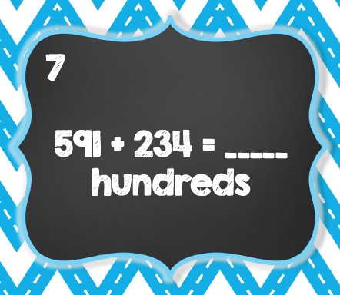
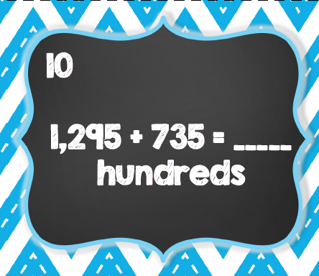
Plenary
Estimating when Rounding

Slide 14
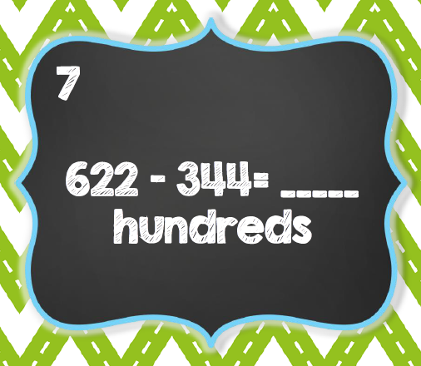
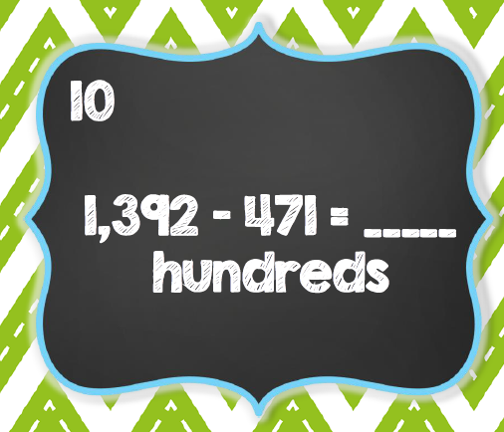
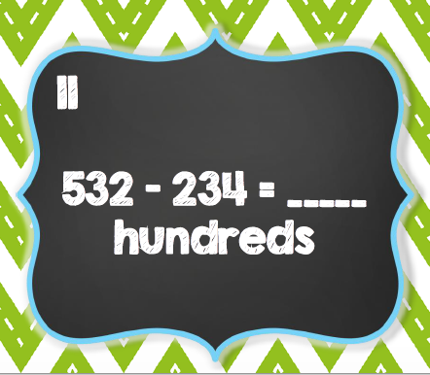
Plenary
Estimating when Rounding

