Slide 1
DAY TWO

Slide 2
Counting
Partitioning

Slide 3
542
3215
500
40
2
3000
500 + 40 +2 =
542
10
5
200
3000+200+10+5 =
3215

Slide 4
You do!
55
69
23
109
123
435
748
1276
9845
4630

Slide 5
Learn Its
Times Tables

Slide 6
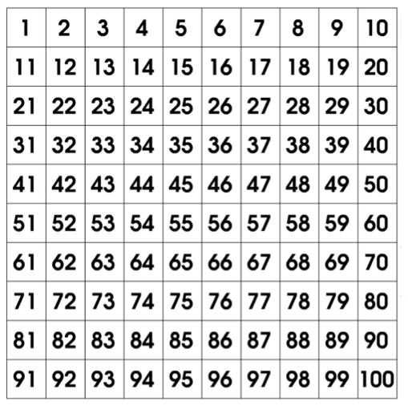
2 x Table
1 x 2 =
2
2 x 2 =
4
3 x 2 =
6
4 x 2 =
8
5 x 2 =
10
6 x 2 =
12
7 x 2 =
14
8 x 2 =
16
9 x 2 =
18
10 x 2 =
20
11 x 2 =
22
12 x 2 =
24

Slide 7
2 x Table
3 x 2 =
revision

Slide 8
2 x Table
6 x 2 =
revision

Slide 9
2 x Table
9 x 2 =
revision

Slide 10
2 x Table
7 x 2 =
revision

Slide 11
2 x Table
2 x 2 =
revision

Slide 12
2 x Table
10 x 2 =
revision

Slide 13
2 x Table
5 x 2 =
revision

Slide 14
It’s Nothing New
Adding with Pim

Slide 15
200 + 300 =

Slide 16
600 + 200 =

Slide 17
8000 + 5000 =

Slide 18
9000 + 4000 =

Slide 19
8000 + 7000 =

Slide 20
60 000 + 50 000 =

Slide 21
70 000 + 20 000 =

Slide 22
Calculations
Addition

Slide 23
You do!
33 + 12 =
78 + 32 =
89 + 19 =
163 + 22 =
244 + 31 =
395 + 47 =

Slide 24
WALT:
Identify the value of digits within a number.
WILF:
Say the value of the number
Work as a team

Slide 25
68974 is a 5digit number.
We can find out what each digit stands for by breaking it down and partitioning it.
6
0
0
0
0
6
8
9
7
4
8
0
0
0
9
0
0
7
0
4
60 000
8000
900
70
4
What does the 4 stand for?
What does the 8 stand for?
What does the 6 stand for?
Lets write the number in Expanded Form:
60 000 + 8000 + 900 + 70 + 7 = 68974

Slide 26
5
3
2
1
8
50 000
8
200
10
3000
50 000 + 3000 + 200 + 10 + 8 = 53218

Slide 27
6
2
1
0
3
60 000
3
100
0
2000
60 000 + 2000 + 100 + 0 + 3 = 62103

Slide 28
You do!
23 432
43 769
45 612
4. 54 980
5. 12 902
6. 78 213
23
46
65
4. 541
5. 129
6. 473

Slide 29
What is the value of the underlined digit?
23 452
50
43 878
3000
12 453
10 000
18 896
800
67 109
9
89 276
80 000

Slide 30
What is the value of the underlined digit?
43 217
200
89 098
8
12 678
2000
18 871
70
68 927
60 000
12 246
40

Slide 31
Plenary
Quiz, Quiz Trade
Partner A shows a number underlined and Partner B says the value. Partner B repeats to Partner A. Swap cards and find a new partner.

