Slide 1
DAY THREE

Slide 2
Counting
Partitioning

Slide 3
290
5329
200
90
0
200+90+0=
290
5000
20
9
300
5000+300+20+9 =
5329

Slide 4
563
2087
500
60
3
500 + 60 + 3 =
563
2000
80
7
000
2000 + 000 + 80 + 7 =
2087

Slide 5
You do!
32
12
135
389
203
876
550
1982
7639
6289

Slide 6
Learn Its
Times Tables

Slide 7
2 x Table Switchers
3 x 2 =
6
2 x 3 =
6
revision

Slide 8
2 x Table Switchers
9 x 2 =
18
2 x 9 =
18
revision

Slide 9
2 x Table Switchers
6 x 2 =
12
2 x 6 =
12
revision

Slide 10
2 x Table Switchers
10 x 2 =
20
2 x 10 =
20
revision

Slide 11
2 x Table Switchers
2 x 2 =
4
2 x 2 =
4
revision

Slide 12
2 x Table Switchers
7 x 2 =
14
2 x 7 =
14
revision

Slide 13
2 x Table Switchers
5 x 2 =
10
2 x 5 =
10
revision

Slide 14
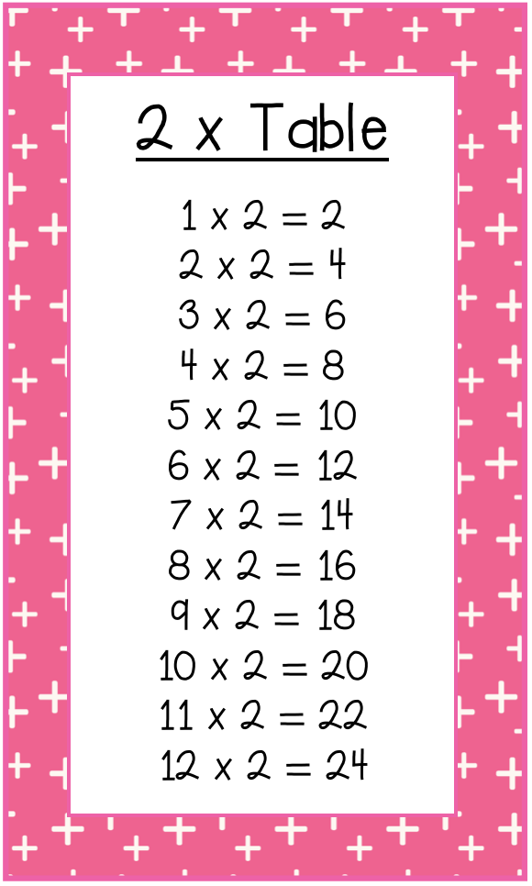
2, 4, ____, 8 , ____, 12
6
10
24, ____, 28, ____, 32
26
30
12, 14, 16, ____, _____
18
20
4
10
0, ___, ____, 6, 8, ____
2
____, 26, 24, _____, 20
28
22
___, ___, 16, ___, 20
12
14
18
32, _____, 36, 38,____
34
40

Slide 15
Calculations
Subtractions

Slide 16
83 - 42
44 - 71
95 - 47
86 - 19
54 - 33
You do!

Slide 17
WALT:
Represent numbers in different ways
WILF:
Identify the value of digits in a number
Represent numbers in Standard, Written, Expanded form

Slide 18
Lets recap:
Standard Form:
34 567
Written Form:
thirty four thousand, five hundred and sixty seven
Expanded Form:
30 000 + 4000 + 500 + 60 + 7

Slide 19
4 Minute Challenge
Challenge your partner to write a 5 digit number in standard form and expanded form. Check and swap.
E.g:
6
2
1
0
3
60 000
3
100
0
2000
60 000 + 2000 + 100 + 0 + 3 = 62103

Slide 20
you do
What is the value of the underlined digit?
43 517
500
89 098
8
16 678
6000
18 891
90
78 927
70 000
12 216
10

Slide 21
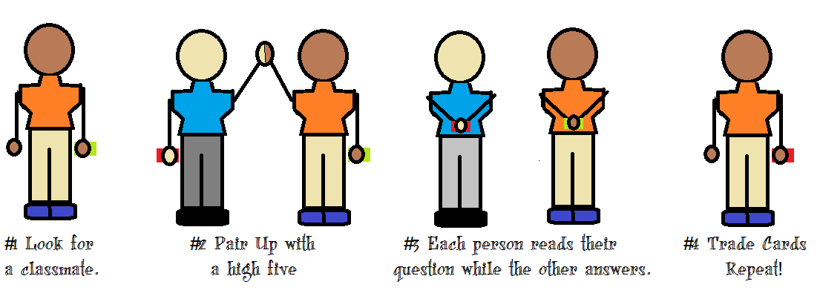
Quiz Quiz Trade
Write a 5 digit number on your whiteboards. Underline one digit. Pair up and identify the value of the underlined digit on your partners Whiteboard. Swap your board with the partner so you have a new card. Find a new partner.

Slide 22
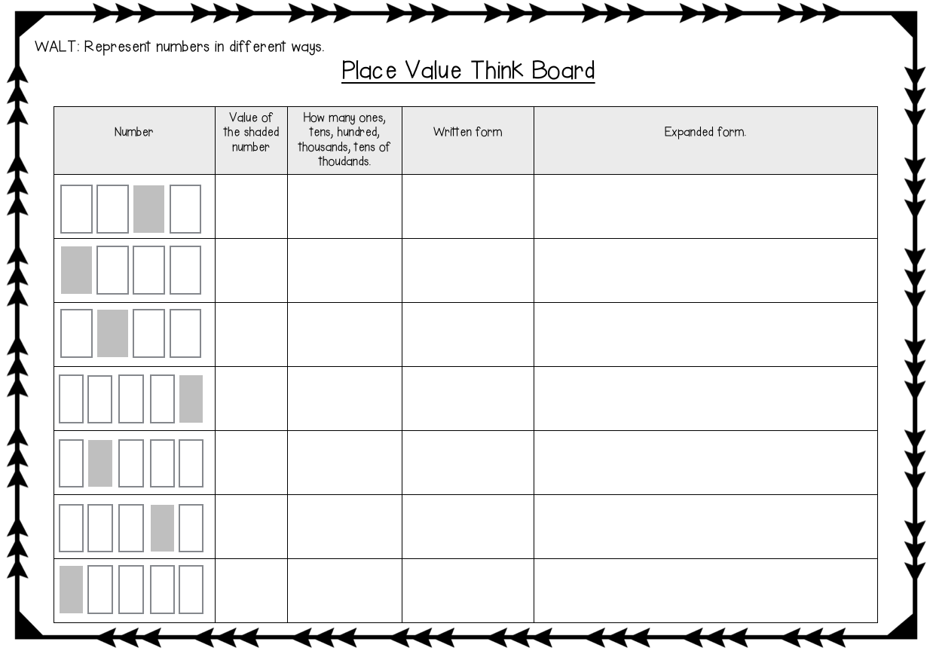
Model the think board task with students.

Slide 23
Plenary
Play Lock it in:
Ten Thousand | Thousand | Hundreds | Tens | Ones

