Slide 1
DAY FOUR

Slide 2
Counting
Partitioning

Slide 3
307
300
7
9834
0
300+0+7=
307
9000
30
4
800
9000+800+30+4 =
9834

Slide 4
985
900
5
6021
80
900 + 80 + 5 =
985
6000
20
1
000
6000 + 000 + 20 + 1 =
6021

Slide 5
You do!
42
63
154
247
143
232
4453
6298
7378
5490

Slide 6
Learn Its
Times Tables

Slide 7
2 x Table Switchers
3 x 2 =
6
2 x 3 =
6
revision

Slide 8
2 x Table Switchers
9 x 2 =
18
2 x 9 =
18
revision

Slide 9
2 x Table Switchers
6 x 2 =
12
2 x 6 =
12
revision

Slide 10
2 x Table Switchers
10 x 2 =
20
2 x 10 =
20
revision

Slide 11
2 x Table Switchers
2 x 2 =
4
2 x 2 =
4
revision

Slide 12
2 x Table Switchers
7 x 2 =
14
2 x 7 =
14
revision

Slide 13
2 x Table Switchers
5 x 2 =
10
2 x 5 =
10
revision

Slide 14
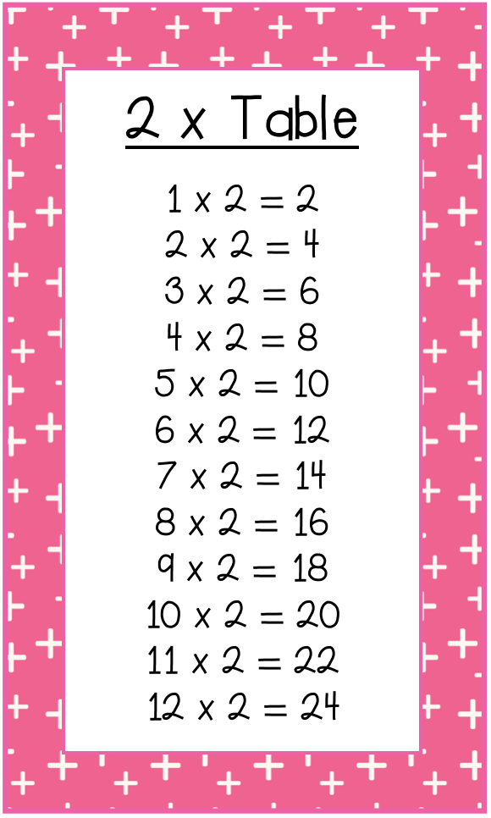
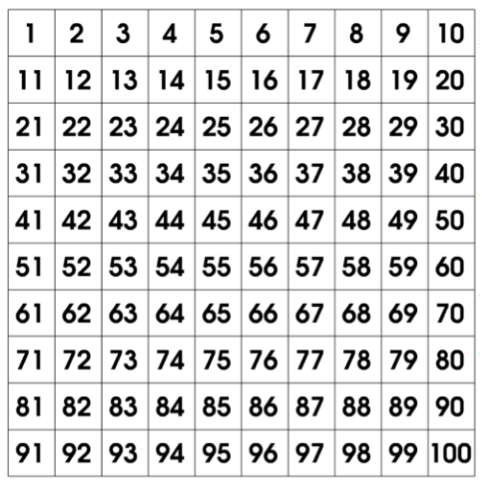

Slide 15
Which of these balloons is a multiple
Of 2 (part of the 2 times tables)?
27
18
36
12
9
24
38
42
12
45
24
28
99
63
72
81
What are the number sentences that match the answers?

Slide 16
Calculations
Addition

Slide 17
You do!
44 – 16 =
54 – 32 =
23 – 19 =
435 – 22 =
231 – 31 =
657 – 47 =

Slide 18
WALT:
Use large numbers in real life
WILF:
Read and write 5 & 6 digit numbers
Understand what the numbers mean.
Represent in standard and written form.

Slide 19
Lets recap:
Standard Form:
34 567
Written Form:
thirty four thousand, five hundred and sixty seven
Expanded Form:
30 000 + 4000 + 500 + 60 + 7

Slide 20
I/we do
Standard Form | Written form | Expanded Form
12657
 | forty five thousand, three hundred and sixty one
341 36
 |  | 70 000 + 1000 + 900 + 20 + 8
 |  | 50 000 + 6000 + 300 + 30 + 2
 | thirty seven thousand, two hundred and eight

Slide 21
You do
Standard Form | Written form | Expanded Form
34124
 | twenty three thousand, two hundred and eleven
76213
 |  | 90 000 + 3000 + 500 + 10 + 3
 |  | 40 000 + 6000 + 500 + 80 + 0
 | ten thousand and eight seven

Slide 22
you do
What is the value of the underlined digit?
43 517
500
89 098
8
16 678
6000
18 891
90
78 927
70 000
12 216
10

