Slide 1
DAY FIVE

Slide 2
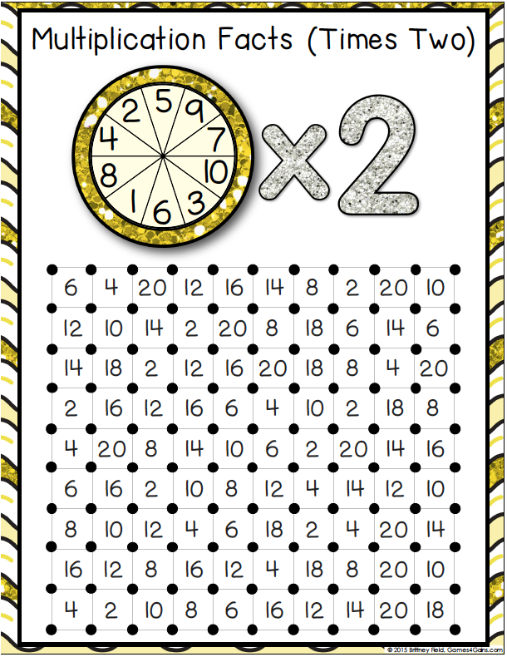

Slide 3
WALT:
Find ‘more than’ and ‘less than’ a given number within 100 000.
WILF:
Add and subtract multiples of 10
Bridging carefully
Check your work with a calculator.

Slide 4
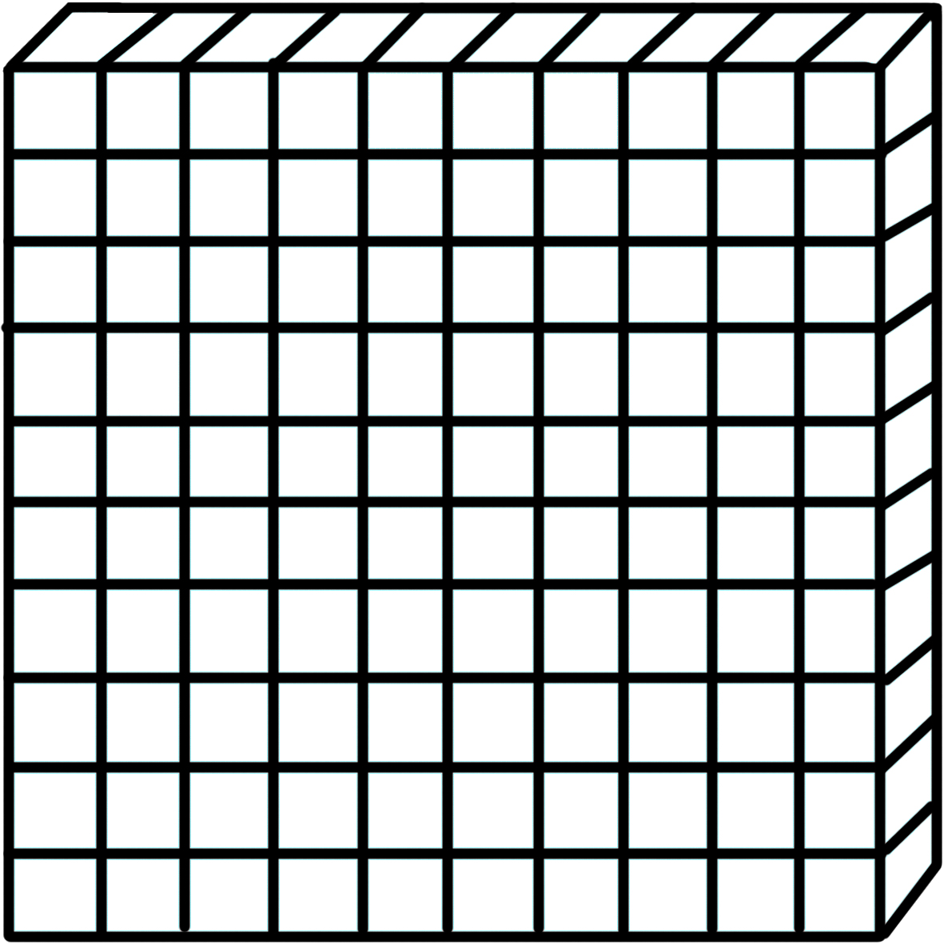
123
How would we make this with MABs?
Can you draw it on your Whiteboard?
What would that look like in a Place Value Chart?
Hundred | Tens | Ones
1 | 2 | 3
What would happen if we added ten?

Slide 5
191
How would we make this with MABs?
Can you draw it on your Whiteboard?
What would that look like in a Place Value Chart?
Hundred | Tens | Ones
1 | 9 | 1
What would happen if we added ten?

Slide 6
2465
How would we make this with MABs?
Can you draw it on your Whiteboard?
What would that look like in a Place Value Chart?
Ten Thousand | Thousand | Hundred | Tens | Ones
 | 2 | 4 | 6 | 5
What would happen if we added one hundred?

Slide 7
1929
How would we make this with MABs?
Can you draw it on your Whiteboard?
What would that look like in a Place Value Chart?
Ten Thousand | Thousand | Hundred | Tens | Ones
 | 1 | 9 | 2 | 9
What would happen if we added one hundred?

Slide 8
157
How would we make this with MABs?
Can you draw it on your Whiteboard?
What would that look like in a Place Value Chart?
Hundred | Tens | Ones
1 | 5 | 7
What would happen if we subtracted ten?

Slide 9
203
How would we make this with MABs?
Can you draw it on your Whiteboard?
What would that look like in a Place Value Chart?
Hundred | Tens | Ones
2 | 0 | 3
What would happen if we subtracted ten?

Slide 10
407
How would we make this with MABs?
Can you draw it on your Whiteboard?
What would that look like in a Place Value Chart?
Hundred | Tens | Ones
4 | 0 | 7
What would happen if we subtracted ten?

Slide 11
1241
How would we make this with MABs?
Can you draw it on your Whiteboard?
What would that look like in a Place Value Chart?
Thousand | Hundred | Tens | Ones
1 | 2 | 4 | 1
What would happen if we subtracted one hundred?

Slide 12
3076
How would we make this with MABs?
Can you draw it on your Whiteboard?
What would that look like in a Place Value Chart?
Thousand | Hundred | Tens | Ones
1 | 2 | 4 | 1
What would happen if we subtracted one hundred?

Slide 13
You do!
2134 - 1000 =
8716 + 100 =
19 021 - 1000 =
12 453 + 10 000 =
34 565 - 10 000 =
521 - 10 =
321 + 100 =
231 - 100 =
546 + 10 =

