Slide 1
DAY SIX

Slide 2
Counting
Reading numbers
(Step 7,8,9)

Slide 3
4567

Slide 4
8923

Slide 5
12 321

Slide 6
90 879

Slide 7
45 651

Slide 8
51 234

Slide 9
13 461

Slide 10
231 454

Slide 11
873 342

Slide 12
980 720

Slide 13
320 819

Slide 14
213 453

Slide 15
Learn Its
Times Tables

Slide 16
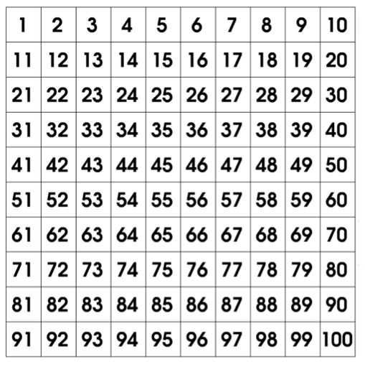
revision
5 x Table
1 x 5 =
5
2 x 5 =
10
3 x 5 =
15
4 x 5 =
20
5 x 5 =
25
6 x 5 =
30
7 x 5 =
35
8 x 5 =
40
9 x 5 =
45
50
10 x 5 =
55
11 x 5 =
12 x 5 =
60

Slide 17
It’s Nothing New
Fact Families
(Step 1)

Slide 18
Fact Families
I do
2 + 4 =
2 + 4 = 6
2
4 + 2 = 6
switcher
6 - 4 = 2
6 - 2 = 4
switcher
4
6

Slide 19
Fact Families
I do
3 + 5 =
3 + 5 = 8
3
5 + 3 = 8
switcher
8 - 3 = 5
8 - 5 = 3
switcher
5
8

Slide 20
Fact Families
we do
4 +n5 =
4 + 5 = 9
4
5 + 4 = 9
switcher
9 - 5 = 4
9 - 4= 5
switcher
5
9

Slide 21
Fact Families
you do
4 + 3 =
7 + 2 =
6 + 5 =
+
=
+
=
+
=
-
=
-
=
-
=
-
=
-
=
-
=

Slide 22
Calculations
Multiplication

Slide 23
You do!
12 x 4 =
23 x 2 =
17 x 5 =
34 x 2 =
25 x 4 =
19 x 3 =

Slide 24
WALT:
To compare numbers within 100 000
WILF:
Know what < > = mean
Use the symbols < > =
Complete 10

Slide 25
We can use a Place Value chart to help us to compare the numbers more easily.
Ten Thousands | Thousands | Hundred | Tens | Ones
5 | 6 | 7 | 0 | 0
7 | 5 | 6 | 0 | 0
When we compare numbers we always start by comparing the digits from the greatest Place Value. Lets look at the digits in the ten thousands column.
Which digit is smaller 5 or 7?
So we know that 56700 is smaller than 75600.
What symbols can we use to compare these two number?
<
>

Slide 26
Lets compare these numbers:
Ten Thousands | Thousands | Hundred | Tens | Ones
3 | 2 | 6 | 4 | 5
3 | 2 | 4 | 9 | 8

Slide 27
Lets compare these numbers:
Ten Thousands | Thousands | Hundred | Tens | Ones
1 | 8 | 6 | 3 | 5
1 | 8 | 6 | 9 | 2

Slide 28
65 378 63 187
You do
12 345 12 546
34 398 43 135
56 780 58 759
90 115 89 987
45 444 45 442
17 543 17 546
77 213 77 231

