Slide 1
DAY SEVEN

Slide 2
Counting
Partitioning

Slide 3
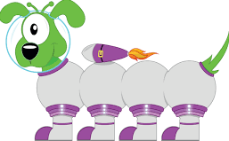
542
3215
500
40
2
3000
10
5
500 + 40 +2 =
542
200
3000+200+10+5 =
3215

Slide 4
You do!
435
1276
9845
4630
45 324
56 781
55
69
23
109
123

Slide 5
Learn Its
Times Tables

Slide 6
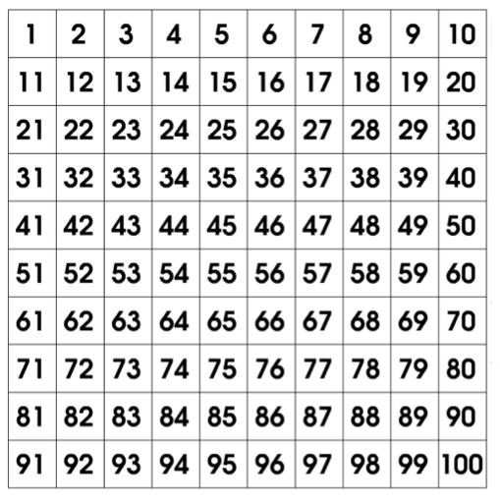
5 x Table
1 x 5 =
5
10
2 x 5 =
3 x 5 =
15
4 x 5 =
20
5 x 5 =
25
6 x 5 =
30
35
7 x 5 =
40
8 x 5 =
45
9 x 5 =
50
10 x 5 =
11 x 5 =
55
12 x 5 =
60
revision

Slide 7
3 x 5 =

Slide 8
9 x 5 =

Slide 9
5 x 5 =

Slide 10
2 x 5 =

Slide 11
7 x 5 =

Slide 12
8 x 5 =

Slide 13
6 x 5 =

Slide 14
5 x Table
25
6 x 5 =
5 x 5 =
30
8 x 5 =
40
9 x 5 =
45
7 x 5 =
35
10 x 5=
50
4 x 5 =
20
12 x 5=
60
0 x 5=
11 x 5 =
55
5

Slide 15
It’s Nothing New
Fact Families
(Step 4)

Slide 16
Fact Families
I do
5 + 4 =
5 + 4 = 9
5
4 + 5 = 9
switcher
9 - 4 = 5
9 - 5 = 4
switcher
4
9

Slide 17
Fact Families
I do
7 x 5 =
7 + 5 = 12
7
5 + 7 = 12
switcher
12 - 5 = 7
12 - 7 = 5
switcher
5
12

Slide 18
Fact Families
we do
4 + 9 =
8 + 7 =
3 + 5 =

Slide 19
Fact Families
you do
4 + 10 =
8 + 6 =
5 + 5 =
+
=
+
=
+
=
-
=
-
=
-
=
-
=
-
=
-
=
Extension:
2 + 3 =
8 + 4 =
6 + 5 =
9 + 5 =

Slide 20
Calculations
Multiplication

Slide 21
You do!
23 x 4 =
17 x 2 =
21 x 5 =
44 x 2 =
19 x 4 =
32 x 3 =

Slide 22
WALT:
To compare numbers within 100 000
WILF:
Understand the terms ascending and descending
Arrange numbers in order

Slide 23
Before we can order the numbers we have to compare them like we did last lesson.
Ten Thousands | Thousands | Hundred | Tens | Ones
3 | 9 | 6 | 2 | 5
3 | 9 | 5 | 6 | 2
4 | 0 | 0 | 2 | 5
Lets put them in ascending order:
Lets put them in descending order:

Slide 24
Before we can order the numbers we have to compare them like we did last lesson.
Ten Thousands | Thousands | Hundred | Tens | Ones
5 | 9 | 6 | 1 | 5
5 | 9 | 5 | 6 | 2
5 | 9 | 6 | 3 | 5
Lets put them in ascending order:
Lets put them in descending order:

Slide 25
Before we can order the numbers we have to compare them like we did last lesson.
Ten Thousands | Thousands | Hundred | Tens | Ones
4 | 5 | 7 | 1 | 6
4 | 5 | 8 | 6 | 3
3 | 9 | 7 | 3 | 7
Lets put them in ascending order:
Lets put them in descending order:

Slide 26
Put these numbers in ascending order:
78 345
78 354
72 134
Put these numbers in ascending order:
23 241
23 421
22 132
Put these numbers in ascending order:
67 213
56 221
68 324

Slide 27
Human Ordering
Read your number.
In your small group, get into ascending order.
Challenge
Can the whole class order themselves in ascending order?

Slide 28
Plenary
Game

