Slide 1
DAY NINE

Slide 2
Counting
Partitioning

Slide 3
307
9834
300
0
7
300+0+7=
307
9000
30
4
800
9000+800+30+4 =
9834

Slide 4
You do!
42
63
154
247
143
232
4453
6298
7378
5490

Slide 5
Learn Its
Times Tables

Slide 6
5 x Table Switchers
3 x 5 =
15
5 x 3 =
15
revision

Slide 7
2 x Table Switchers
9 x 5 =
45
5 x 9 =
45
revision

Slide 8
2 x Table Switchers
6 x 5 =
30
5 x 6 =
30
revision

Slide 9
2 x Table Switchers
10 x 5 =
50
5 x 10 =
50
revision

Slide 10
2 x Table Switchers
2 x 5 =
10
5 x 2 =
10
revision

Slide 11
2 x Table Switchers
7 x 5 =
35
5 x 7 =
35
revision

Slide 12
2 x Table Switchers
5 x 5 =
25
5 x 5 =
25
revision

Slide 13
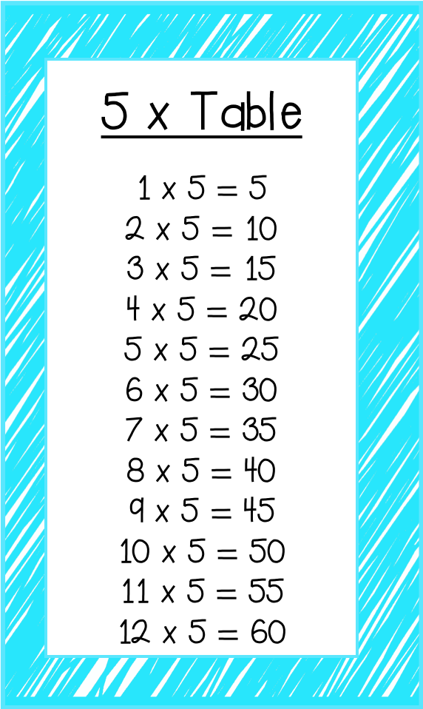
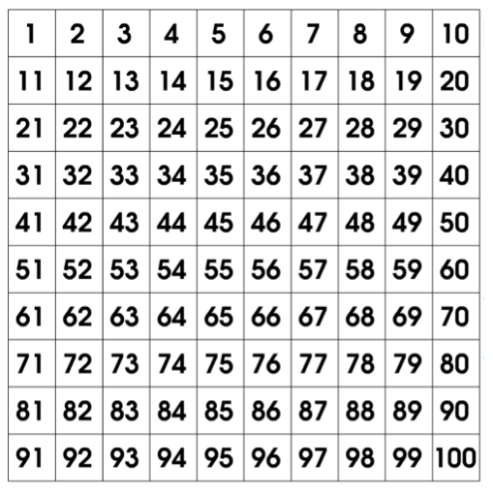

Slide 14
Which of these balloons is a multiple
Of 5 (part of the 5 times tables)?
27
18
35
12
5
25
40
42
10
45
24
20
100
63
70
81
What are the number sentences that match the answers?

Slide 15
It’s Nothing New
Fact Families

Slide 16
5
we do
5
Fact Families
4
4
9
8 + 4 =
7 - 3 =
9 - 7 =

Slide 17
Fact Families
Rally Write
5 + 4 =
9 + 2 =
8 - 4 =
8 - 5 =
+
=
-
=
+
=
-
=
+
=
-
=
+
=
-
=
+
=
-
=
+
=
-
=
8 + 8 =
4 - 2 =
9 - 1 =
7 + 4 =
-
=
-
=
+
=
+
=
+
=
+
=
-
=
-
=
=
+
=
-
=
-
=
+

Slide 18
Calculations
Division

Slide 19
You do!
48 ÷ 4 =
36 ÷ 2 =
25 ÷ 5 =
70 ÷ 2 =
45 ÷ 3 =
92 ÷ 4 =

Slide 20
WALT:
To round numbers to the nearest 10
WILF:
Use a number line
Know the rounding rule

Slide 21
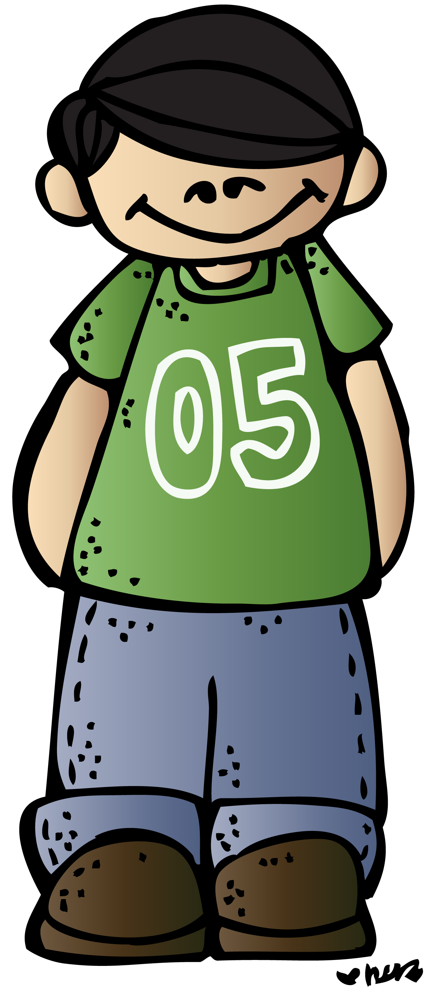
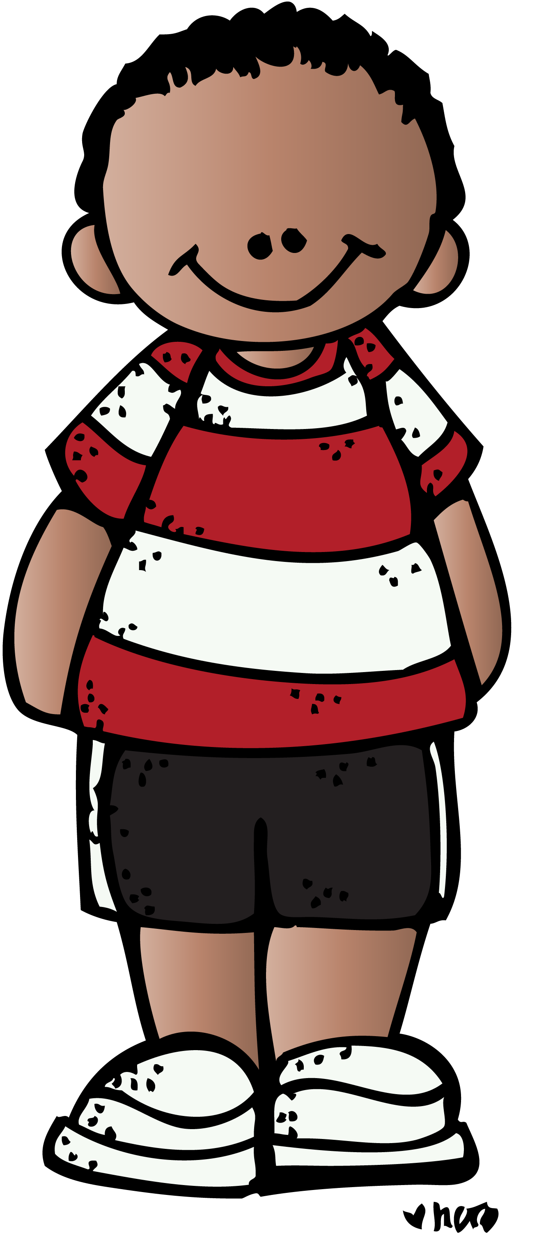
I have about $70.
Our Savings
I have about $60.
Sophie $61
Jake $68
Eli $75
I have about $80.
Jake
Sophie
Eli
Who has saved the most money?
Least money?
How do you know?
Have a look at the estimations on the right.
What do you notice?
Each child has rounded their money to an approximate value - in this case, to the nearest 10.

Slide 22
We can use a number line to help us when we are rounding.
Lets work out how to round 61 to the nearest 10…
61
60
70
We can see that 61 is closer to 60 so we round down.
We write this as… 61≈60.
The ≈ sign is the approximation sign and it means ‘approximately’.

Slide 23
79
We write this as… ≈
15
We write this as… ≈

Slide 24
128
We write this as… ≈
303
We write this as… ≈

Slide 25
1092
We write this as… ≈
1785
We write this as… ≈

Slide 26
The Rounding Rule…Nearest 10
We can also use the rounding rule to help us to identify whether we round a number up or down.
Tens | Ones
4 | 3
1
5
2
6
3
7
4
8
9
We always look at the ones place to help us!
https://www.youtube.com/watch?v=pNfz-JU2cKE

Slide 27
The Rounding Rule… Nearest 100
1
5
2
6
We can also use the same rounding rule to help us to identify whether we round a number up or down when rounding to the nearest 100.
3
7
4
8
9
Hundred | Tens | Ones
2 | 4 | 3
We always look at the tens place to help us!
https://www.youtube.com/watch?v=pNfz-JU2cKE

Slide 28
We do!
16 ≈
321 ≈
45 ≈
5479 ≈
12 ≈
5567 ≈
89 ≈
3421 ≈
123 ≈
8788 ≈
458 ≈
8792 ≈

Slide 29
1, 2, 3, 4
Stand up, Sit down
5, 6, 7, 8, 9
65
208
32
27
4209
666
1287
804
6793
224
563

Slide 30
Plenary
Estimating when Rounding

